Slide 1
Drivers of Natural Gas Prices In The United States
Group Members:
Wilson Aliaga
Carlton Lewis
Velmarini Vasquez

Slide 2
Project Questions
Supply Drivers questions
How does production vary over time in different regions of the country, especially in the counties with natural gas reserves?
How does the Storage changes over time based on the facilities (e.g. Pipelines) available in the counties or regions with natural gas reserves?
How does Imported gas contribute to the supply overtime?
Demand questions
How does temperature changes affect gas demand?
How does economic growth influence gas consumption?

Slide 3
Data Set Sources
U.S. Energy Information Administration (EIA)
World Weather
Federal Reserve Economic Data (FRED)
US Census Database

Slide 4
Data Exploration
Demand
Obtain and analyze the following data:
Residential consumption over time
Industrial consumption over time
Commercial consumption vs time
Exports over time
Supply
Obtain and analyze the following data:
Production over time
Reserve changes over time.
Capacity and storage use of each state of the country overtime, and the create a time dependent Google Heat Map.
Imports over time
Pipelines and Liquid natural gas terminals (LNG)

Slide 5
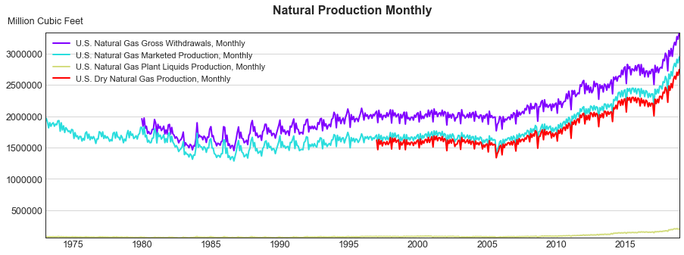
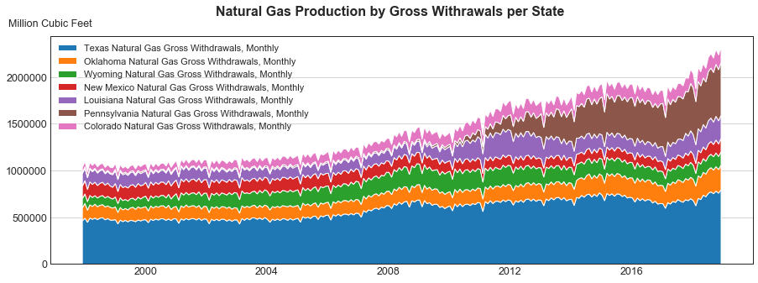

Slide 6
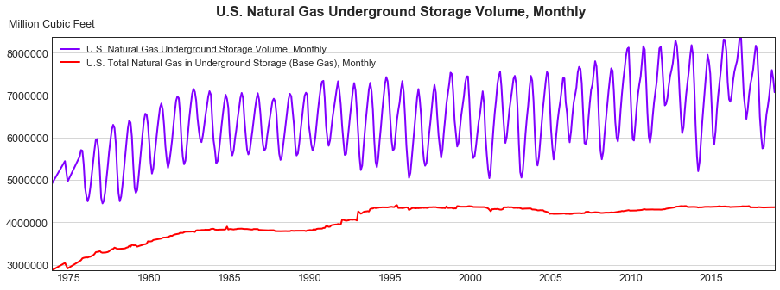
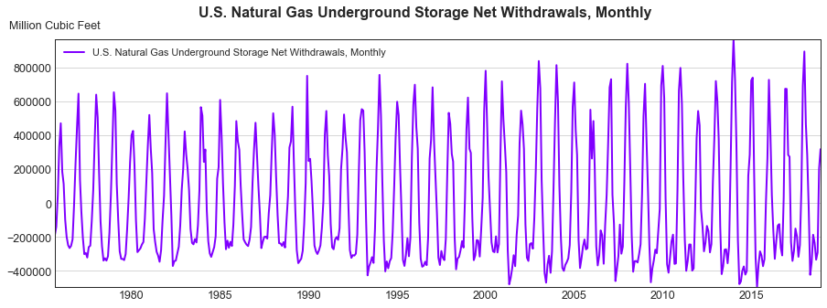

Slide 7
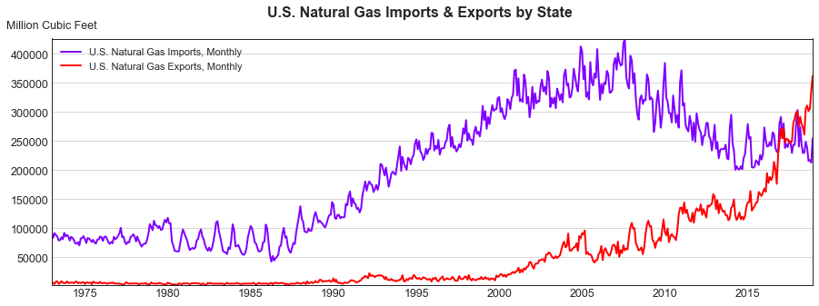
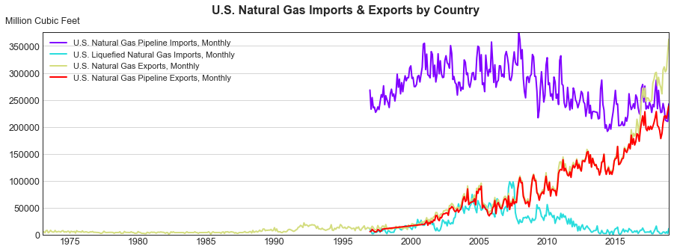

Slide 8
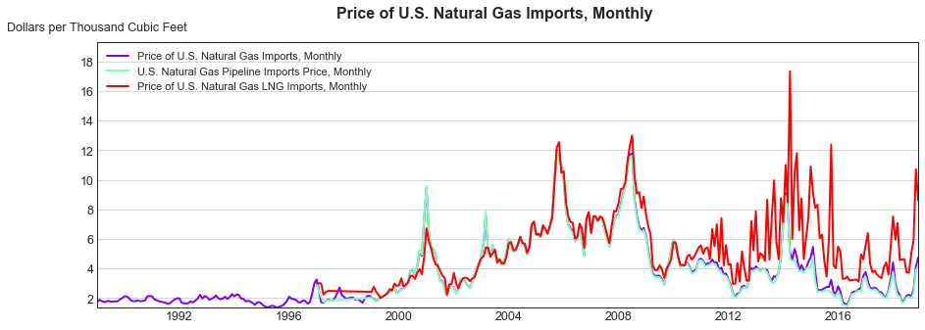
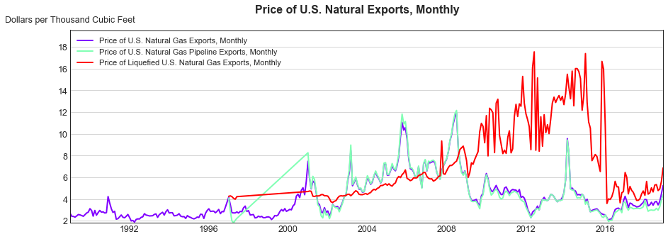

Slide 9
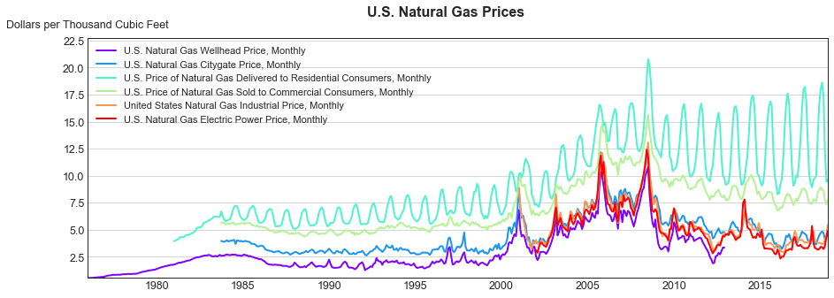
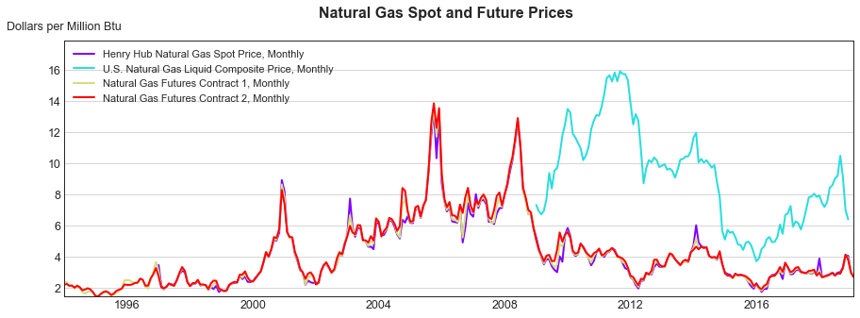

Slide 10
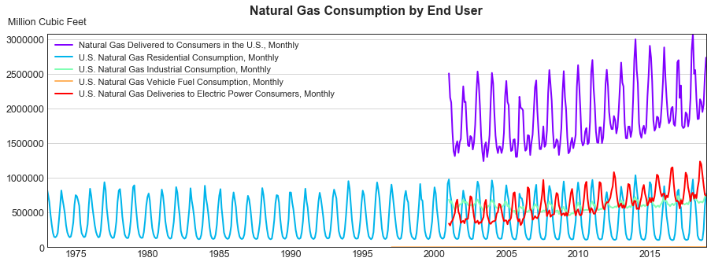
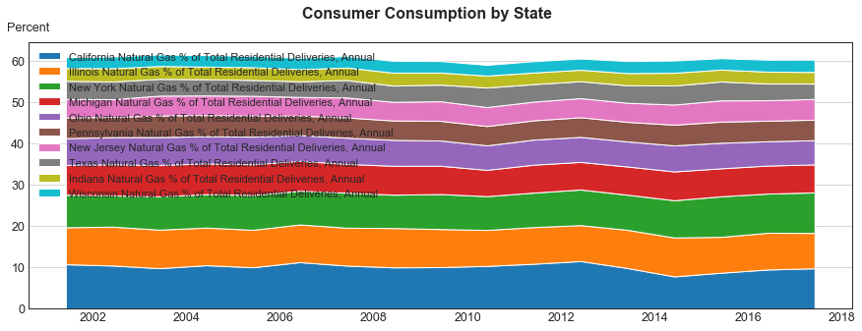

Slide 11
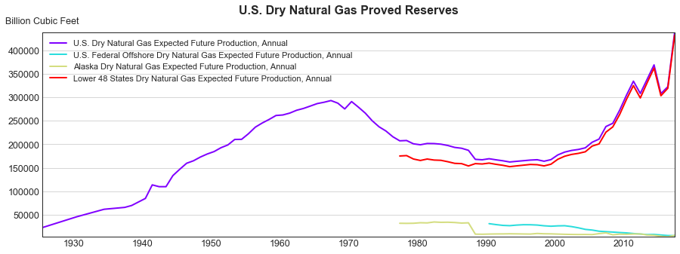
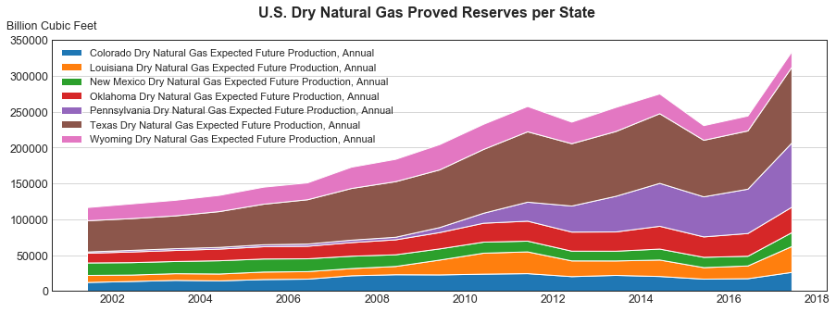

Slide 12
Analysis Process
The data exploration and cleanup process (accompanied by your Jupyter Notebook)

Slide 14
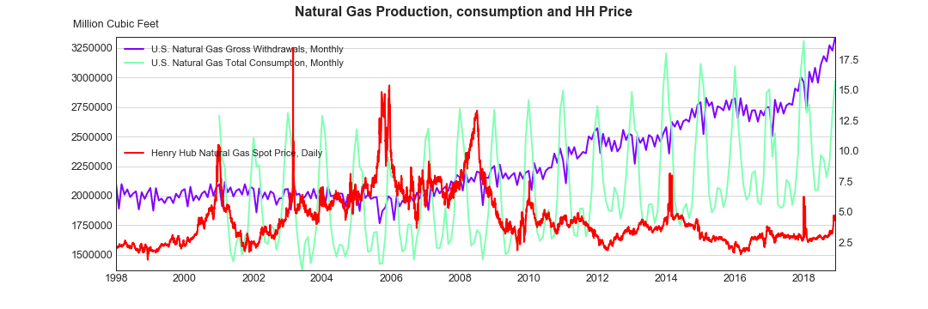
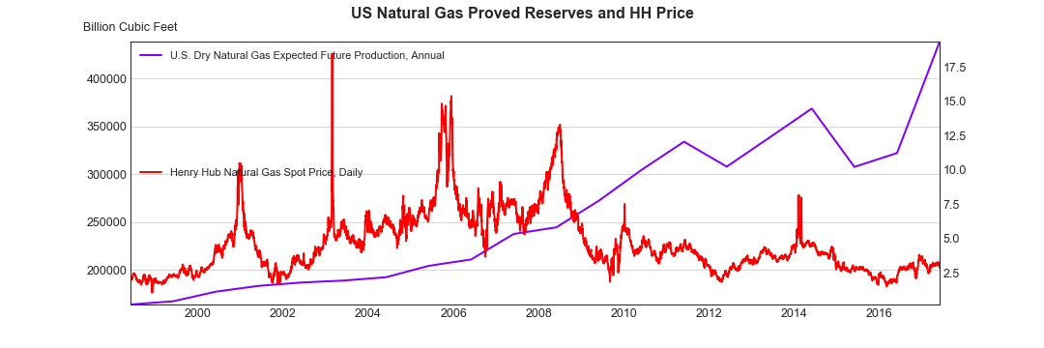

Slide 15
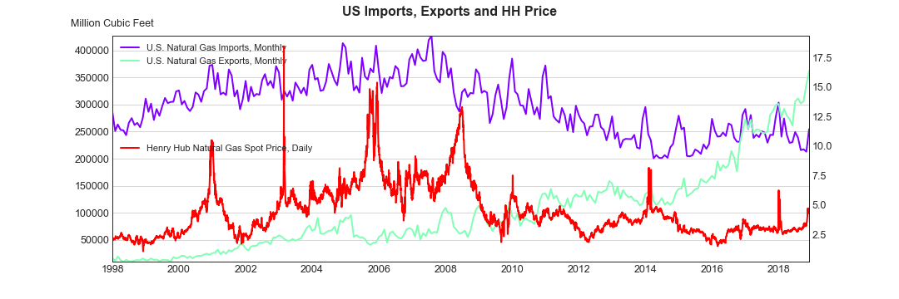
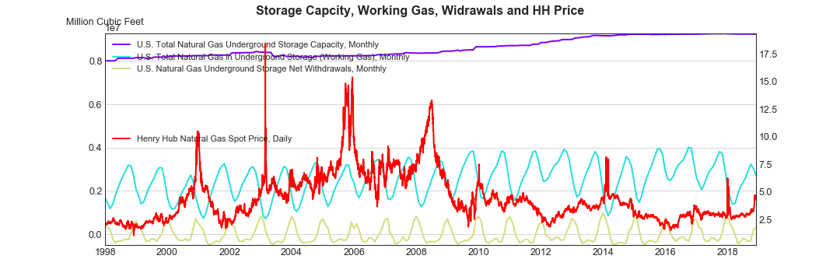

Slide 16
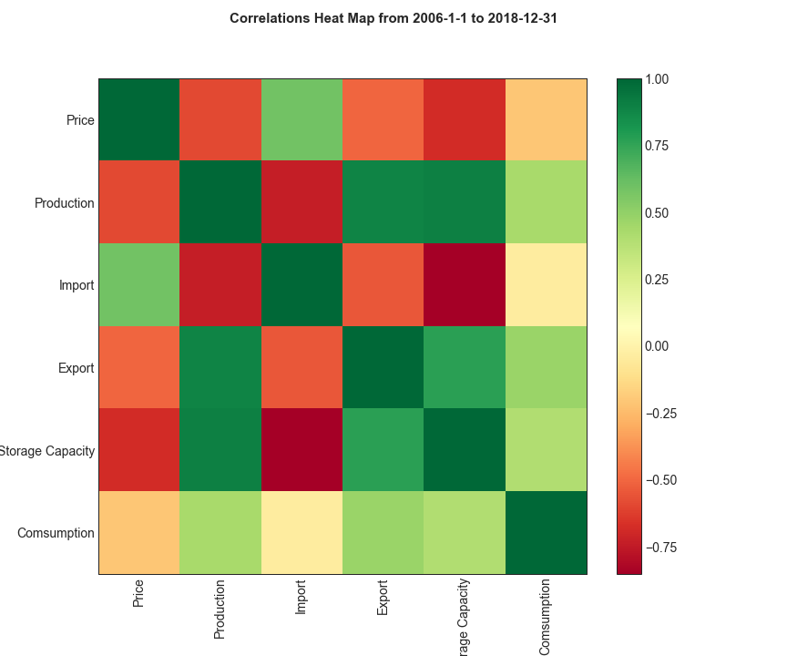

Slide 17
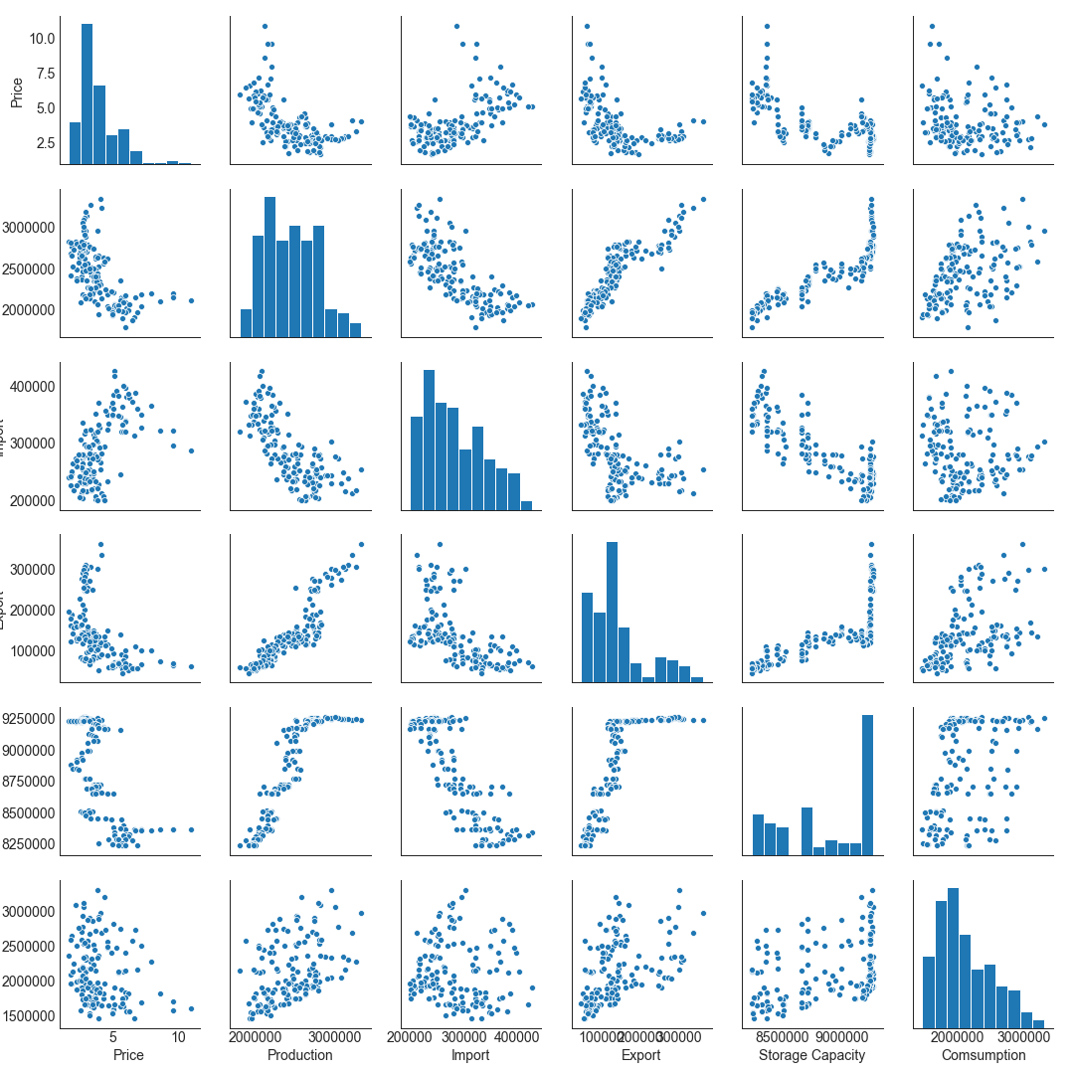

Slide 18
conclusions
This should include a numerical summary as well as visualizations of that summary

Slide 19
implications of the findings
This is where you get to have an open-ended discussion about what your findings "mean".

